Slide 1
CSE332 INDUSTRY ETHICS AND LEGAL ISSUES

Slide 2
Patents

Slide 3
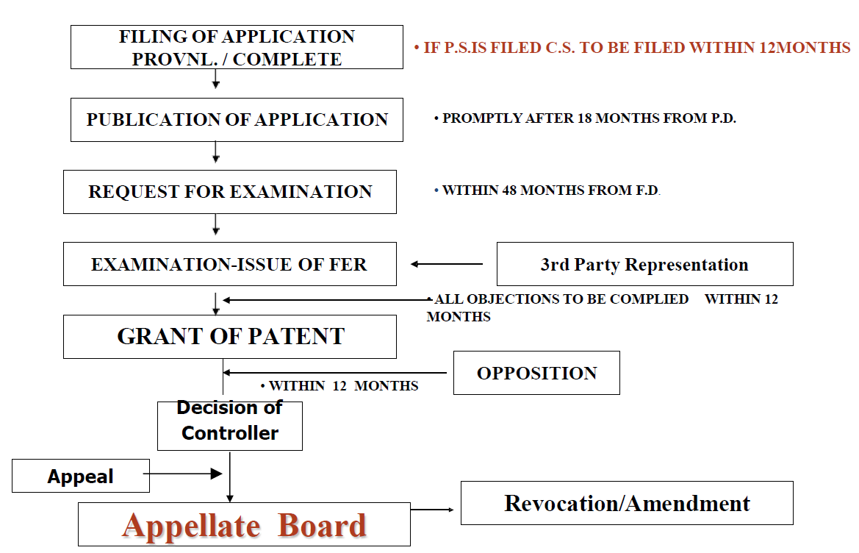
Stages from filing to grant of a patent

Slide 4
Publication and Examination
Rule24-B:Examinationofapplication
Examination request for application:
1. 48 months from filing date or priority date, whichever or 6 months from further application filing.
2. Controller refers to Examiner within 1 month from publication or examination request receipt date whichever is earlier.
3. Examiner prepares report in 1-3 months.

Slide 5
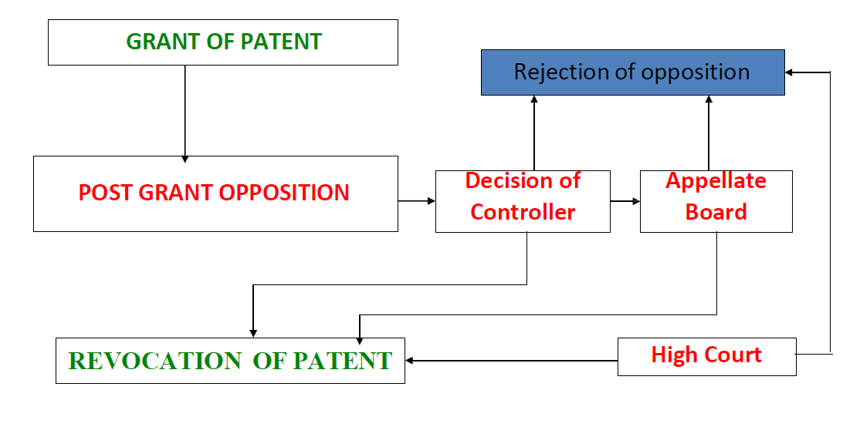
A PROCEDURE FROM FILING TO
GRANT OF PATENT (Cont.)

Slide 6
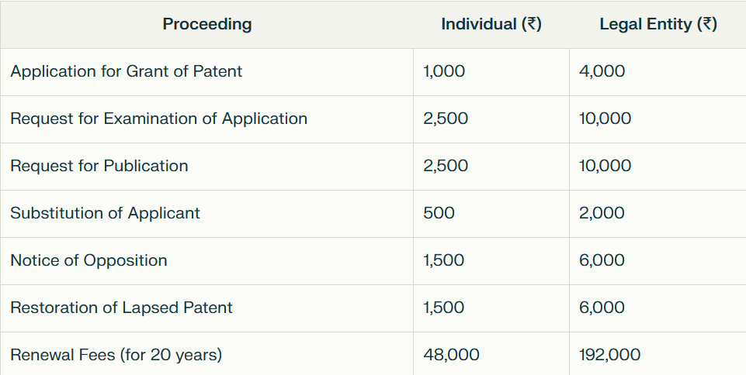
IMPORTANT FEES IN DIFFERENT PROCEEDINGS

Slide 7
DUTIES OF PATENTEE
Maintenance of the patent
Pay renewal fees
Every year till the end of the term
Time limit:
before end of the preceeding year ( 6months extn. Available )
Working of the patents:
Inventions are to be worked in India on commercial scale

Slide 8
Litigation vs Licensing
If the objective is to stop a
competitor from offering a
product that infringes one’s patent.
If the objective is to obtain royalty
for the use of one’s invention.
Alternatives To Litigation
Litigations are costly, timely, & disruptive
Alternative dispute resolutions (ADR) include Mediation & Arbitration

